Slide 1
Cloud Elevate –Exam Readiness workshop AWS Certified Developer - Associate
Developing and Deepening
Cloud skills @ATCI

Slide 2
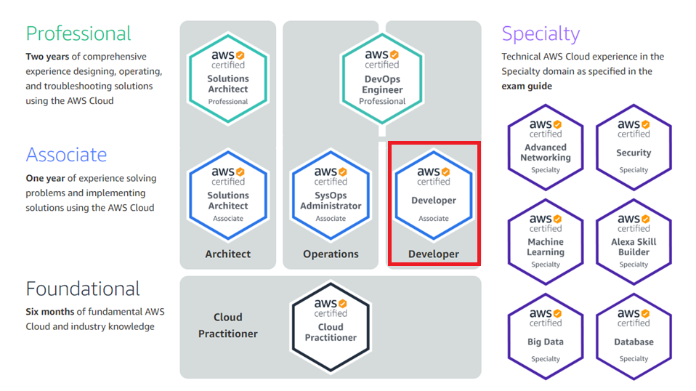
AWS CERTIFICATION PATH
https://aws.amazon.com/certification/
2

Slide 3
AWS Developer - associate
AWS Developer - Associate Exam Guide (Exam Blueprint)
Domain | % of Exam
a. Deployment | 22%
b. Security | 26%
c. Development with AWS | 30%
d. Refactoring | 10%
e. Monitoring and Troubleshooting | 12%
Total | 100%

Slide 4
Development with AWS– 30%
Objectives
Write code for serverless applications
Translate functional requirements into application design
Implement application design into application code
Write code that interacts with AWS by using APIs, SDKs, and AWS Command Line Interface (AWS CLI)

Slide 5
Development with AWS– 30%
Key AWS Services
Amazon S3
Amazon Lambda
Amazon DynamoDB
Amazon CloudFront
Amazon ElastiCache
Amazon API Gateway
Amazon ECS
AWS Step Functions
AWS SNS
AWS SQS
AWS SDK and CLI

Slide 6

Amazon S3 (Simple storage service)
AWS S3 is an object storage service where you can store and retrieve any amount of data, at any time and from anywhere
AWS S3 stores data as objects within buckets. Buckets are the containers for the objects
AWS provides unlimited storage space and individual s3 objects can range in the size from 0 bytes to maximum of 5 terabytes
The largest object that can be uploaded in a single PUT operation is 5 gigabytes. If the object are larger than 100 megabytes consider using multipart upload capability

Slide 7
Amazon S3 (Simple storage service) – Storage Classes
Storage Class | What it was Designed for ? | Durability | Availability | Availability Zones | Min. storage duration | Min. billable object size
Standard | Frequently accessed Data | 99.999999999% | 99.99% | >= 3 | None | None
Standard IA | Long-lived infrequently accessed data | 99.999999999% | 99.9% | >= 3 | 30 days | 128 kb
Intelligent Tiering | Long-lived data with changing unknown access patterns | 99.999999999% | 99.9% | >= 3 | 30 days | None
OneZone IA | Long-lived infrequently accessed data, non-critical data | 99.999999999% | 99.5% | 1 | 30 days | 128 kb
Glacier | Archived data with retrieval times ranging from minutes to hours | 99.999999999% | 99.99% | >= 3 | 90 days | None
Glacier Deep Achieve | Archived data with retrieval times in hours | 99.999999999% | 99.99% | >= 3 | 180 days | None
Reduced Redundancy | Frequently accessed non-critical data | 99.99% | 99.99% | >= 3 | None | None

Slide 8
LAMBDA
Lambda(Serverless computing) is an execution model where you can build and run applications and services without having to manage the infrastructure.
Your applications still run on servers but the server management is completely done by the cloud providers. You only need to worry about writing the code.
In serverless, applications are broken up into individual functions that can be invoked and scaled individually.
Services like AWS Lambda, Azure Functions take care of the infrastructure, operating system and operating servers or run time environments.
Benefits :
- No server management
- Flexible scaling
- Pay for what you execute
- Highly available

Slide 9
LAMBDA
AWS Lambda is a FaaS (Functions-as-a-Service) from AWS.
AWS Lambda lets you run your code without provisioning or managing the servers. Lambda runs your code with zero-administration from your end.
You will pay only for the compute time when the code is running and there are no charges when the code is not running.
You can you AWS Lambda in response to events. Such as Lambda can be triggered if changes to the data in S3 bucket or DynamoDB table.
Lambda will take care of the infrastructure, operating system and run time environments of the supported languages and Lambda does not provide access to the underlying infrastructure.
Currently Lambda supports following languages: Java, NodeJS, Python, .NET, Go, Ruby
Lambda scales automatically and process few to thousands of requests per second. All you need to do is supply your code.
Maximum Lambda function execution time is 15 minutes. You can publish new versions of Lambda functions

Slide 10

Amazon Dynamodb
Amazon DynamoDB is a fast and flexible non-relational database service for all applications that need consistent, single-digit millisecond latency at any scale. It is a fully managed cloud database and supports both document and key-value store models.
Fully managed
Fast, Consistent Performance
Fine-grained access control
Flexible
Amazon DynamoDB

Slide 11
Amazon DynamoDB – Core components
Tables
DynamoDB stores data in the form of tables similar to RDBMS
A table is a collection of data
DynamoDB tables are schema less (other than the primary key you need not define any other attributes)
Items
A table can contain zero or more items
An item is a group of attributes that is uniquely identifiable among all of the other items
Item should be smaller then 400KB
Attributes
Each item is composed of one or more attributes
Attributes are similar to fields or columns in other database systems
{
id:”1”,
name:”Jack”
}
item
attribute
{
id:”2”,
name:”James”,
address: {
city: “Bangalore”, state:”Karnataka”
}

Slide 12
Amazon DynamoDB – Core components
Example:
{
"Id":"123",
"Name":"sam",
"Age":"29"
}
{
"Id":"123",
"Name":["sam","Bob"],
}
Supported Datatypes:
String
Number
Binary
Boolean
Null
List (any types) - "List":[1,"sam",True]
set of String(Unique values) "Friends":["Sam","bob"]
set of Binary(unique values) "Images":["3d..affdd","4dffed...deff"]
set of Number(unique value) "Number":[1,24,5,4,7,9]
Map "Address": {
"No":"123"
"street":"xyz street"
"city":"abc"
}

Slide 13
Amazon DynamoDB – Core components
Partition key:
A simple primary key, composed of one attribute known as the partition key
Each table should have the partition key
Every item should have it with same types
Each item should have a unique value
Help to query and get a single item
Used in Hash function to determine the physical storage
Partition Key
UserID | Email | Name
1 | sam@demo.com | Sam
2 | John@example.com | John
3 | Bob@sample.com | Bob

Slide 14
Amazon DynamoDB – Core components
Composite Key (Partition key and sort key ):
Composed of two attributes. The first attribute is the partition key, and the second attribute is the sort key
All items with the same partition key value are stored together, in sorted order by sort key value
Helps to query and get Multiple items
All items should have both partition key and sort key
Pair should be unique
Partition Key
User ID | Last Login Time | Email | Name
101 | 2018-01-03T10:1e.30 | sam@demo.com | Sam
201 | 2018-01-04T10:19:30 | John@example.com | John
301 | 2018-03-04T1a.2a.20 | Bob@sample.com | Bob
Sort Key

Slide 15
How Dynamodb works
Amazon DyanamoDB reads and write the data using Hashing mechanism
Key
Consistent Hashing
F(“key”)
Default Hashing
Nodes
255
67%256=67
Key1
Key3
Value
Value
Key
F(“key”)
Index
196
64
Key2
Key1
Value
Copy
Value
128

Slide 16
Read/Write Consistency
DynamoDB maintains multiple copies of data for durability.
All copies are usually consistent within a second after write operation.
Read consistency levels.
Eventually consistent read may return slightly stale data if a read operation is performed immediately after a write operation.
Strongly consistent read returns most up-to-date data.
Transactional provides ACID consistency.
Write consistency levels.
Standard
Transactional provides ACID consistency.
You can specify the desired consistency level when reading data.

Slide 17
Scaling in DynamoDB
Need to specify capacity | No Need to configure anything
Cheaper per request | More expensive per request
Good for established application | Good for new applications
Useful when there are traffic pattens | Useful when traffic are adhoc

Slide 18
Read and Write Throughput
Read Capacity Unit (RCU): Number of strongly consistent reads per second of items up to 4 KB in size.
Eventually consistent reads use half the provisioned read capacity.
Formula: Read Capacity
(ITEM SIZE (rounded up to the next 4KB multiplier) / 4KB) * # of items (Round up to the nearest 4 KB multiplier)
Example:
An item size of 3 KB and we want to read 80 (strongly consistent read) items per second per table
80 * (3KB (round up to 4) / 4KB)
80 * 1 = 80 required provisioned read throughput
Eventually consistent reads:
(80 * 1) / 2 = 40 required read capacity

Slide 19
Read and Write Throughput
Write Capacity Unit (WCU): Number of 1 KB writes per second.
Throughput is divided evenly among partitions.
Formula: Write Capacity
(ITEM SIZE (rounded up to the next 1KB multiplier) / 1KB) * # of items (Round up to the nearest 1 KB multiplier)
Example:
We need 10 writes per second, and we have an item of size 1.5KB, how much throughput is required?
(ITEM SIZE (1.5KB) / 1 KB) x 10 = 20 capacity units

Slide 20
Amazon Dyanamodb partitions
Amazon DynamoDB each partition can store up to 10 GB of data
Once it filled up it will split into two
Formula to calculate no of partition
By Capacity : RCU/3000 + WCU/1000
By Size : Total Size / 10 GB
Result No : ceiling(max(Capacity,Size))

Slide 21
Amazon Dyanamodb – Secondary Indexing
Allow you to query data based on non-primary key attributes.
A secondary index defines an alternate key.
Contain:
Alternate key attributes.
Primary key attributes.
Optional subset of other attributes from the base table (Projected attributes).
Can be one of two types:
Global Secondary Index (GSI) – 20 GSI per table
Local Secondary Index (LSI) – 5 LSI per table

Slide 22
Local Secondary Indexing
The characteristics of a local secondary index are:
The partition key is the same as the table’s partition key. The sort key can be any scalar attribute.
It can only be created when a table is created and It cannot be deleted.
It supports eventual consistency and strong consistency.
It does not have its own provisioned throughput. Instead, it uses the table’s read and write capacity units.
All the items with a particular partition key in the table and the items in the corresponding local secondary index are stored on the same partition.
The total size of an item collection cannot exceed 10 GB.
Partition Key
LSI
LSI
User ID | Last Login Time | Email | Name | Account Expire Year
101 | 2018-01-03T10:1e.30 | sam@demo.com | Sam | 2019
201 | 2018-01-04T10:19:30 | John@example.com | John | 2020
301 | 2018-03-04T1a.2a.20 | Bob@sample.com | Bob | 2021
Sort Key

Slide 23
Global Secondary Indexing
The characteristics of a global secondary index are:
It can have a partition key and optional sort key that are different from the partition key and sort key of the original table.
Key values do not need to be unique.
It can be created when a table is created or can be added to an existing table.
It can be deleted.
It supports eventual consistency only.
It has its own provisioned throughput settings for read and write operations.
Queries only return attributes that are projected into the index.
Partition Key
GSI Sort Key
User ID | Last Login Time | Email | Name | Account Expire Year
101 | 2018-01-03T10:1e.30 | sam@demo.com | Sam | 2019
201 | 2018-01-04T10:19:30 | John@example.com | John | 2020
301 | 2018-03-04T1a.2a.20 | Bob@sample.com | Bob | 2021
Sort Key
GSI Partition Key

Slide 24
Amazon dynamodb - Streams
DynamoDB Streams:
Captures data modification events in DynamoDB
Each event is represented by a stream record
DynamoDB Streams writes a stream record whenever,
A new item is added to the table
An item is updated
An item is deleted from the table
Each stream record contains,
name of the table
event timestamp
and other metadata
Use it with AWS Lambda with trigger
User ID | Last Login Time | Email | Name | Account Expire Year
101 | 2018-01-03T10:1e.30 | sam@demo.com | Sam | 2019
Asynchronous update to stream
User ID | Last Login Time | Email | Name | Account Expire Year
101 | 2018-02-03T10:a.30 | sam123@demo.com | Sam | 2019
Shard1
Last Login Time: 2018-01-03T10:1e.30
Last Login Time: 2018-01-05T10:1b.30
Shard n

Slide 25
Amazon dynamodb – Backup
On-demand backup
on-demand backup and restore capabilities allows you to create full backups of your tables.
The backup is created asynchronously by applying all changes until the time of the request to the last full table snapshot
Point in time Recovery
Automatic backup mechanism help to protect your Amazon DynamoDB tables from accidental write or delete operations
. DynamoDB maintains incremental backups of your table.
restore that table to any point in time during the last 35 days

Slide 26
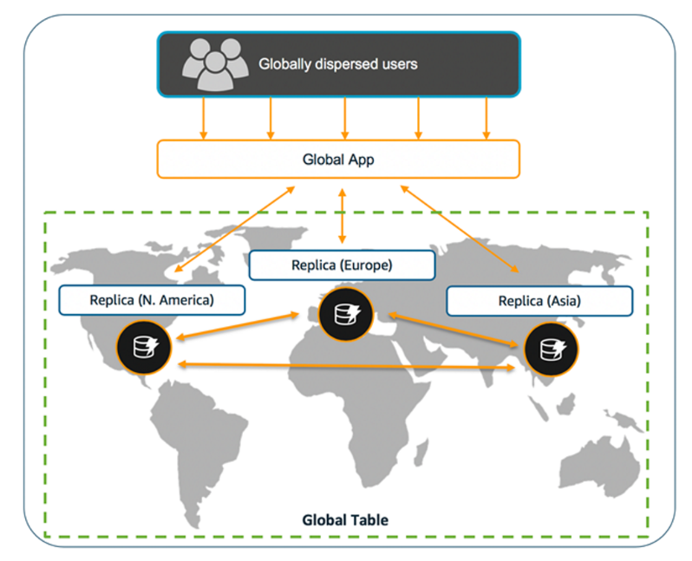
Amazon dynamodb – Global Tables
A global table is a collection of one or more DynamoDB tables, all owned by a single AWS account, identified as replica tables.
DynamoDB global tables can be created in three steps:
Create an ordinary DynamoDB table, with DynamoDB Streams enabled, in an AWS Region.
Repeat step 1 for every other AWS Region where you want to replicate your data.
Define a DynamoDB global table based on the tables that you have created.

Slide 27
DynamoDB Accelerator (DAX)
DAX is a DynamoDB-compatible caching service that enables you to benefit from fast in-memory performance for demanding applications. DAX addresses three core scenarios:
As an in-memory cache, DAX reduces the response times of eventually-consistent read workloads by an order of magnitude, from single-digit milliseconds to microseconds.
DAX reduces operational and application complexity by providing a managed service that is API-compatible with Amazon DynamoDB, and thus requires only minimal functional changes to use with an existing application.
For read-heavy or bursty workloads, DAX provides increased throughput and potential operational cost savings by reducing the need to over-provision read capacity units. This is especially beneficial for applications that require repeated reads for individual keys.

Slide 28
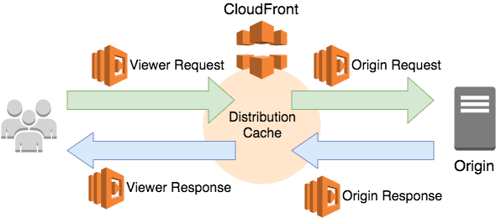
CloudFront
Amazon CloudFront is a web service that speeds the distribution of static and dynamic web content, such as .html, .css, .js, and image files, to your users.
CloudFront delivers your content through a worldwide network of data centers called edge locations, where it caches the content closer to your users.
Key Features:
HTTP/HTTPS'File'Delivery'
Private'Content'
Programma2c'Invalida2on'
Industrydcompliant,'detailed'Access'Logs'
AWS'Management'Console'
Full'control'via'APIs

Slide 29



Amazon ElastiCache
Easy to deploy, operate, and scale an in-memory cache in the cloud and support Memcached and Redis opensource in memory engine
App Reads
Lazy Loading: Loads data into the cache only when necessary
Write Through: Adds data or updates data in the cache whenever data is written to the database
APPs
EC2 Instances
ElastiCache
HTTP/HTTPS Request
Cache
Updates
Database Reads
HTTP/HTTPS Response
Database Writes
Database

Slide 30
Amazon API Gateway
Allows you to create APIs that act as front doors for your applications to access data, business logic, or functionality from your backend services.
Fully manages and handles all tasks involved in accepting and processing up to hundreds of thousands of concurrent API calls.
Can handle workloads running on:
Amazon EC2
AWS Lambda
Any web application
AWS Resources
S3
HTTP
methods
REST
API Gateway
Compute Resources (EC2 or Lambda)
RDS
DyanmoDB

Slide 31


SIMPLE NOTIFICATION SERVICE
Producer and consumer interacts asynchronously with subscribers by producing and sending a message to a topic.
SNS can be easily managed from AWS CLI, Console ,AWS SDK libraries tools, and AWS tools for Windows PowerShell .
Lambda
SQS
HTTP/S
Email
SMS
Publisher
Multiple SNS Topics
Subscriber

Slide 32
SIMPLE NOTIFICATION SERVICE
Amazon Simple Notification Service (SNS) is an easily accessible, reliable , secure pub /sub messaging service that enables you to decouple microservices, distributed systems and serverless applications
By using SNS it is easy to send notifications from the cloud.
Developers can easily publish message from an application and get it immediately deliver to subscribers or other applications.
SNS is a web service which coordinates and manages the delivery or sending of messages to endpoints or subscribers.
SNS is a push based service which provides the ability to create topic which is a logical access point and a platform for communication.

Slide 33
SnS TRANSPORT PROTOCOLS
HTTP/HTTPS:
Subscribers specify URL and messages or notifications will be delivered through an HTTP POST to specified URL.
Email, Email-JSON:
Messages are sent via email to registered addresses in text format. Email-JSON sends notifications as a JSON object.
SQS:
Users can specify a SQS queue as the endpoint; SNS will ask the specified queue to receive a notification message (which subscribers can then process using SQS APIs such as ReceiveMessage, DeleteMessage, etc.)
SMS:
Messages will be sent to registered telephone numbers as SMS text messages.

Slide 34
SIMPLE QUEUE SERVICE(SQS)
SQS is a web service that lets you access a message queue which can be used to store message while waiting for a computer to process them
SQS offers a highly scalable ,reliable queue for storing messages in transit between computers.
It needs very little configuration and no administrative overhead.
Messages are of 256KB of text in any format either JSON, XML or plain text.
Also provides Dead Letter Queue(A queue for messages which can not be processed after a maximum number of attempts)
SQS offers 2 types of queues:
Standard: SQS Standard queue ensures delivery of message at least once.
FIFO: SQS First In First Out queue ensures delivery of message exactly once hence removing duplicates

Slide 35
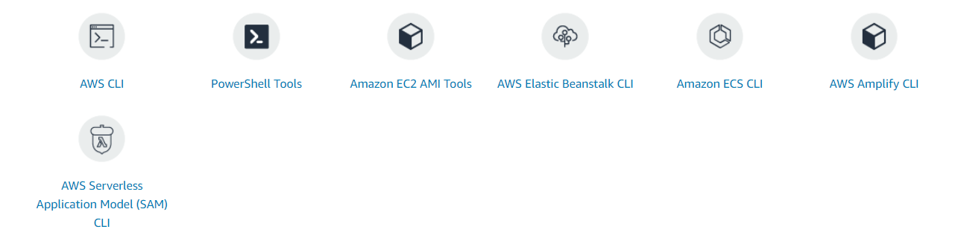
Command Line tools
Control your AWS services from the command line and automate service management with scripts

Slide 36
Command Line tools
Control your AWS services from the command line and automate service management with scripts

Slide 37
clI
Example - EC2 CLI
Service (command)
Operation
(sub-command)
Parameters
$ aws ec2 stop-instances -–instance-id i-1234567890abcdef0
$ aws ec2 run-instances –-cli-input-json file://./lcf/webserver.json
$ aws help
$ aws ec2 help
$ aws ec2 describe-instances help

Slide 38
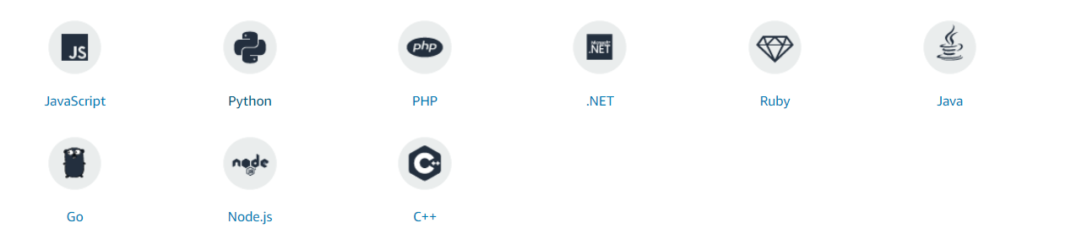
sdk
SDKs take the complexity out of coding by providing language-specific APIs for AWS services

Slide 39
Python SDK – Boto3
Boto3 makes it easy to integrate your Python application, library, or script with AWS services including Amazon S3, Amazon EC2, Amazon DynamoDB, and more.
Key Features
Client and Resource API
Up-to-date and Consistent Interface
Support for Python 2 and 3
Waiters
Service-specific High-level Features

Slide 40
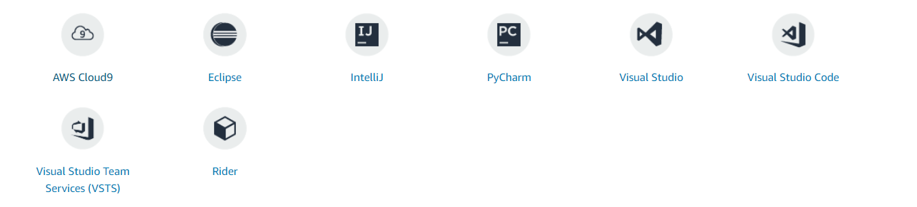
Ide AND ide TOOLKITS
Write, run, debug, and deploy applications on Amazon Web Services using language-specific Integrated Development Environments (IDE)

Slide 41
Sample Questions
An administrator is getting an error while trying to create a new bucket in S3? You feel that bucket limit has been crossed. What is the bucket limit per account in AWS?Choose the correct answer from the options below
a. 50
b. 1000
c. 150
d. 100

Slide 42
Sample Questions
An administrator is getting an error while trying to create a new bucket in S3? You feel that bucket limit has been crossed. What is the bucket limit per account in AWS?Choose the correct answer from the options below
a. 50
b. 1000
c. 150
d. 100

Slide 43
Sample Questions
A company will be uploading several terabytes of data to Amazon S3. What is the SIMPLEST solution to
ensure that the data is encrypted before it is sent to S3 and whilst in transit?
a. Use client-side encryption with a KMS managed CMK and SSL
b. Use server-side encryption with client provided keys
c. Use client-side encryption and a hardware VPN to a VPC and an S3 endpoint
d. Use server-side encryption with S3 managed keys and SSL

Slide 44
Sample Questions
A company will be uploading several terabytes of data to Amazon S3. What is the SIMPLEST solution to
ensure that the data is encrypted before it is sent to S3 and whilst in transit?
a. Use client-side encryption with a KMS managed CMK and SSL
b. Use server-side encryption with client provided keys
c. Use client-side encryption and a hardware VPN to a VPC and an S3 endpoint
d. Use server-side encryption with S3 managed keys and SSL

Slide 45
Sample Questions
A developer has deployed an application on an Amazon EC2 instance in a private subnet within a VPC. The
subnet does not have Internet connectivity. The developer would like to write application logs to an
Amazon S3 bucket. What MUST be configured to enable connectivity?
a. An IAM role must be added to the instance that has permissions to write to the S3 bucket
b. A bucket policy needs to be added specifying the principles that are allowed to write data to the bucket
c. A VPN should be established to enable private connectivity to S3
d. A VPC endpoint should be provisioned for S3

Slide 46
Sample Questions
A developer has deployed an application on an Amazon EC2 instance in a private subnet within a VPC. The
subnet does not have Internet connectivity. The developer would like to write application logs to an
Amazon S3 bucket. What MUST be configured to enable connectivity?
a. An IAM role must be added to the instance that has permissions to write to the S3 bucket
b. A bucket policy needs to be added specifying the principles that are allowed to write data to the bucket
c. A VPN should be established to enable private connectivity to S3
d. A VPC endpoint should be provisioned for S3

Slide 47
Sample Questions
Developer wants to encrypt new objects that are being uploaded to an Amazon S3 bucket by an
application. There must be an audit trail of who has used the key during this process. There should be no
change to the performance of the application. Which type of encryption meets these requirements?
a. Server-side encryption using S3-managed keys
b. Server-side encryption with AWS KMS-managed keys
c. Client-side encryption with a client-side symmetric master key
d. Client-side encryption with AWS KMS-managed keys

Slide 48
Sample Questions
Developer wants to encrypt new objects that are being uploaded to an Amazon S3 bucket by an
application. There must be an audit trail of who has used the key during this process. There should be no
change to the performance of the application. Which type of encryption meets these requirements?
a. Server-side encryption using S3-managed keys
b. Server-side encryption with AWS KMS-managed keys
c. Client-side encryption with a client-side symmetric master key
d. Client-side encryption with AWS KMS-managed keys

Slide 49
Sample Questions
You decide to create a bucket on AWS S3 called ‘newbucket’ and then perform the following actions in the order that they are listed here.
- You upload a file to the bucket called 'file1'
- You upload a file called 'file2'
- You enable versioning on the bucket
Which of the following is true for your bucket 'newbucket'? Choose the correct answer from the options below
a. There will be 1 version ID for file1 and null version ID for file2.
b. There will be 1 version ID for file2 and null version ID for file1.
c. The version ID will be null for both file1 and file2
d. There will be 1 version ID for file1 and file2.

Slide 50
Sample Questions
A serverless application uses an AWS Lambda function to process Amazon S3 events. The Lambda function
executes 20 times per second and takes 20 seconds to complete each execution. How many concurrent
executions will the Lambda function require?
a. 5
b. 400
c. 40
d. 20

Slide 51
Sample Questions
A serverless application uses an AWS Lambda function to process Amazon S3 events. The Lambda function
executes 20 times per second and takes 20 seconds to complete each execution. How many concurrent
executions will the Lambda function require?
a. 5
b. 400
c. 40
d. 20

Slide 52
Sample Questions
A Developer has been tasked by a client to create an application. The client has provided the following
requirements for the application:
• Performance efficiency of seconds with up to a minute of latency
• Data storage requirements will be up to thousands of terabytes
• Per-message sizes may vary between 100 KB and 100 MB
• Data can be stored as key/value stores supporting eventual consistency
What is the MOST cost-effective AWS service to meet these requirements?
a. Amazon DynamoDB
c. Amazon S3
c. Amazon RDS (with a MySQL engine)
d. Amazon ElastiCache

Slide 53
Sample Questions
A Developer has been tasked by a client to create an application. The client has provided the following
requirements for the application:
• Performance efficiency of seconds with up to a minute of latency
• Data storage requirements will be up to thousands of terabytes
• Per-message sizes may vary between 100 KB and 100 MB
• Data can be stored as key/value stores supporting eventual consistency
What is the MOST cost-effective AWS service to meet these requirements?
a. Amazon DynamoDB
c. Amazon S3
c. Amazon RDS (with a MySQL engine)
d. Amazon ElastiCache

Slide 54
Sample Questions
A DynamoDB table is being used to store session information for users of an online game. A developer has
noticed that the table size has increased considerably and much of the data is not required after a gaming
session is completed.
What is the MOST cost-effective approach to reducing the size of the table?
a. Use the batch-write-item API to delete the data
b. Create an AWS Lambda function that purges stale items from the table daily
c. Enable a Time To Live (TTL) on the table and add a timestamp attribute on new items
d. Use the delete-item API to delete the data

Slide 55
Sample Questions
A DynamoDB table is being used to store session information for users of an online game. A developer has
noticed that the table size has increased considerably and much of the data is not required after a gaming
session is completed.
What is the MOST cost-effective approach to reducing the size of the table?
a. Use the batch-write-item API to delete the data
b. Create an AWS Lambda function that purges stale items from the table daily
c. Enable a Time To Live (TTL) on the table and add a timestamp attribute on new items
d. Use the delete-item API to delete the data

Slide 56
Sample Questions
A company recently migrated a multi-tier application to AWS. The web tier runs on an Auto Scaling group of
Amazon EC2 instances and the database tier uses Amazon DynamoDB. The database tier requires extremely
high performance and most requests are repeated read requests.
What service can be used to scale the database tier for BEST performance?
a. Amazon CloudFront
b. Amazon ElastiCache
c. Amazon DynamoDB Accelerator (DAX)
d. Amazon SQS

Slide 57
Sample Questions
A company recently migrated a multi-tier application to AWS. The web tier runs on an Auto Scaling group of
Amazon EC2 instances and the database tier uses Amazon DynamoDB. The database tier requires extremely
high performance and most requests are repeated read requests.
What service can be used to scale the database tier for BEST performance?
a. Amazon CloudFront
b. Amazon ElastiCache
c. Amazon DynamoDB Accelerator (DAX)
d. Amazon SQS

Slide 58
Sample Questions
A static website that serves a collection of images runs from an Amazon S3 bucket in the us-east-1 region.
The website is gaining in popularity and a is now being viewed around the world. How can a Developer
improve the performance of the website for global users?
a. Use cross region replication to replicate the bucket to several global regions
b. Use Amazon S3 Transfer Acceleration to improve the performance of the website
c. Use Amazon ElastiCache to cache the website content
d. Use Amazon CloudFront to cache the website content

Slide 59
Sample Questions
A static website that serves a collection of images runs from an Amazon S3 bucket in the us-east-1 region.
The website is gaining in popularity and a is now being viewed around the world. How can a Developer
improve the performance of the website for global users?
a. Use cross region replication to replicate the bucket to several global regions
b. Use Amazon S3 Transfer Acceleration to improve the performance of the website
c. Use Amazon ElastiCache to cache the website content
d. Use Amazon CloudFront to cache the website content

Slide 60
Sample Questions
An application uses an Auto Scaling group of Amazon EC2 instances, an Application Load Balancer (ALB), and
an Amazon Simple Queue Service (SQS) queue. An Amazon CloudFront distribution caches content for global
users. A Developer needs to add in-transit encryption to the data by configuring end-to-end SSL between
the CloudFront Origin and the end users. How can the Developer meet this requirement? (Select TWO)
a. Configure the Origin Protocol Policy
b. Create an Origin Access Identity (OAI)
c. Add a certificate to the Auto Scaling Group
d. Configure the Viewer Protocol Policy
e. Create an encrypted distribution

Slide 61
Sample Questions
An application uses an Auto Scaling group of Amazon EC2 instances, an Application Load Balancer (ALB), and
an Amazon Simple Queue Service (SQS) queue. An Amazon CloudFront distribution caches content for global
users. A Developer needs to add in-transit encryption to the data by configuring end-to-end SSL between
the CloudFront Origin and the end users. How can the Developer meet this requirement? (Select TWO)
a. Configure the Origin Protocol Policy
b. Create an Origin Access Identity (OAI)
c. Add a certificate to the Auto Scaling Group
d. Configure the Viewer Protocol Policy
e. Create an encrypted distribution

Slide 62
Sample Questions
An Amazon RDS database is experiencing a high volume of read requests that are slowing down the
database. Which fully managed, in-memory AWS database service can assist with offloading reads from the
RDS database?
a. Amazon RDS Read Replica
b. Amazon Aurora Serverless
c. Amazon ElastiCache Redis
d. Memcached on Amazon EC2

Slide 63
Sample Questions
An Amazon RDS database is experiencing a high volume of read requests that are slowing down the
database. Which fully managed, in-memory AWS database service can assist with offloading reads from the
RDS database?
a. Amazon RDS Read Replica
b. Amazon Aurora Serverless
c. Amazon ElastiCache Redis
d. Memcached on Amazon EC2

Slide 64
Sample Questions
An Amazon ElastiCache cluster has been placed in front of a large Amazon RDS database. To reduce cost the
ElastiCache cluster should only cache items that are actually requested. How should ElastiCache be
optimized?
a. Only cache database writes
b. Enable a TTL on cached data
c. Use a write-through caching strategy
d. Use a lazy loading caching strategy

Slide 65
Sample Questions
An Amazon ElastiCache cluster has been placed in front of a large Amazon RDS database. To reduce cost the
ElastiCache cluster should only cache items that are actually requested. How should ElastiCache be
optimized?
a. Only cache database writes
b. Enable a TTL on cached data
c. Use a write-through caching strategy
d. Use a lazy loading caching strategy

Slide 66
Sample Questions
A company is migrating an on-premises web application to AWS. The web application runs on a single server
and stores session data in memory. On AWS the company plan to implement multiple Amazon EC2 instances
behind an Elastic Load Balancer (ELB). The company want to refactor the application so that data is resilient
if an instance fails and user downtime is minimized. Where should the company move session data to MOST
effectively reduce downtime and make users’ session data more fault tolerant?
a. An Amazon ElastiCache for Redis cluster
b. A second Amazon EBS volume
c. The web server’s primary disk
d. An Amazon EC2 instance dedicated to session data

Slide 67
Sample Questions
A company is migrating an on-premises web application to AWS. The web application runs on a single server
and stores session data in memory. On AWS the company plan to implement multiple Amazon EC2 instances
behind an Elastic Load Balancer (ELB). The company want to refactor the application so that data is resilient
if an instance fails and user downtime is minimized. Where should the company move session data to MOST
effectively reduce downtime and make users’ session data more fault tolerant?
a. An Amazon ElastiCache for Redis cluster
b. A second Amazon EBS volume
c. The web server’s primary disk
d. An Amazon EC2 instance dedicated to session data

Slide 68
Sample Questions
Which of the following is the best way to update an S3 notification configuration, when a change in the lambda version needs to be referred by an S3 bucket after new objects are created in the bucket?
a. Specify Lambda Alias ARN in the notification configuration.
b. Specify Lambda Function ARN in the notification configuration.
c. Specify Lambda Qualified ARN in the notification configuration.
d. Specify Lambda $LATEST ARN in the notification configuration.

Slide 69
Sample Questions
Which of the following is the best way to update an S3 notification configuration, when a change in the lambda version needs to be referred by an S3 bucket after new objects are created in the bucket?
a. Specify Lambda Alias ARN in the notification configuration.
b. Specify Lambda Function ARN in the notification configuration.
c. Specify Lambda Qualified ARN in the notification configuration.
d. Specify Lambda $LATEST ARN in the notification configuration.

Slide 70
Sample Questions
Which of the following is the best way to update an S3 notification configuration, when a change in the lambda version needs to be referred by an S3 bucket after new objects are created in the bucket?
a. Specify Lambda Alias ARN in the notification configuration.
b. Specify Lambda Function ARN in the notification configuration.
c. Specify Lambda Qualified ARN in the notification configuration.
d. Specify Lambda $LATEST ARN in the notification configuration.

Slide 71
Sample Questions
In DynamoDB, how many tables can an AWS account have per region? Choose the correct answer from the options below.
a. 256
b. 282
c. 255
d. 126

Slide 72
Sample Questions
In DynamoDB, how many tables can an AWS account have per region? Choose the correct answer from the options below.
a. 256
b. 282
c. 255
d. 126

Slide 73
Sample Questions
In DynamoDB, how many tables can an AWS account have per region? Choose the correct answer from the options below.
a. 256
b. 282
c. 255
d. 126

Slide 74
Sample Questions
Which API call can be used to retrieve up to 100 items at a time or 1MB of data from a DynamoDB table? Choose the correct answer from the options below.
a. GetItem
b. BatchItem
c. ChunkGetItem
d. BatchGetItem

Slide 75
Sample Questions
Which API call can be used to retrieve up to 100 items at a time or 1MB of data from a DynamoDB table? Choose the correct answer from the options below.
a. GetItem
b. BatchItem
c. ChunkGetItem
d. BatchGetItem

Slide 76
Sample Questions
Which API call can be used to retrieve up to 100 items at a time or 1MB of data from a DynamoDB table? Choose the correct answer from the options below.
a. GetItem
b. BatchItem
c. ChunkGetItem
d. BatchGetItem

Slide 77
Sample Questions
1. Your items are 12KB in size and you want to have 100 strongly consistent reads
per second. How many read capacity units do you need to provision?
Choose the correct answer from the options below
a. 300
b. 80
c. 200
d. 50

Slide 78
Sample Questions
1. Your items are 12KB in size and you want to have 100 strongly consistent reads
per second. How many read capacity units do you need to provision?
Choose the correct answer from the options below
a. 300
b. 80
c. 200
d. 50

Slide 79
Sample Questions
1. Your items are 12KB in size and you want to have 100 strongly consistent reads
per second. How many read capacity units do you need to provision?
Choose the correct answer from the options below
a. 300
b. 80
c. 200
d. 50

Slide 80
Sample Questions
A Start-up company is launching a new web application using AWS Cloud infrastructure. This is a three-tier application behind load balancers with content stored in Amazon S3 buckets within a region & CloudFront for caching of data. Company plans to use its owned domain name. Web content should be delivered at lowest latency to global users. Which of the following is a cost-efficient solution while creating name records with Route 53?
a. Create a CNAME record for web application pointing to Amazon S3 bucket with the same name.
b. Create an Alias record for web application pointing to CloudFront distribution
c. Create an Alias record for web application pointing to Amazon S3 bucket with the same name.
d. Create a CNAME record for web application pointing to CloudFront distribution

Slide 81
Sample Questions
A Start-up company is launching a new web application using AWS Cloud infrastructure. This is a three-tier application behind load balancers with content stored in Amazon S3 buckets within a region & CloudFront for caching of data. Company plans to use its owned domain name. Web content should be delivered at lowest latency to global users. Which of the following is a cost-efficient solution while creating name records with Route 53?
a. Create a CNAME record for web application pointing to Amazon S3 bucket with the same name.
b. Create an Alias record for web application pointing to CloudFront distribution
c. Create an Alias record for web application pointing to Amazon S3 bucket with the same name.
d. Create a CNAME record for web application pointing to CloudFront distribution

Slide 82
Sample Questions
A Start-up company is launching a new web application using AWS Cloud infrastructure. This is a three-tier application behind load balancers with content stored in Amazon S3 buckets within a region & CloudFront for caching of data. Company plans to use its owned domain name. Web content should be delivered at lowest latency to global users. Which of the following is a cost-efficient solution while creating name records with Route 53?
a. Create a CNAME record for web application pointing to Amazon S3 bucket with the same name.
b. Create an Alias record for web application pointing to CloudFront distribution
c. Create an Alias record for web application pointing to Amazon S3 bucket with the same name.
d. Create a CNAME record for web application pointing to CloudFront distribution

Slide 83
Sample Questions
Your company currently has a set of Images that are placed in an S3 bucket. To give better user experience to users across the world, you have created a CloudFront distribution with the S3 bucket as the origin. But in your monitoring reports, you now see that a lot of users are bypassing the CloudFront URL and directly going to the S3 bucket and downloading the images. Which of the following steps can be performed to remediate this issue. Choose 2 answers from the options given below.
a. Create a Cloudfront origin access identity
b. Create a separate IAM user
c. Ensure that only the Cloudfront origin access identity has access to read objects from the S3 bucket.
d. Ensure that only the IAM user has access to read objects from the S3 bucket.

Slide 84
Sample Questions
Your company currently has a set of Images that are placed in an S3 bucket. To give better user experience to users across the world, you have created a CloudFront distribution with the S3 bucket as the origin. But in your monitoring reports, you now see that a lot of users are bypassing the CloudFront URL and directly going to the S3 bucket and downloading the images. Which of the following steps can be performed to remediate this issue. Choose 2 answers from the options given below.
a. Create a Cloudfront origin access identity
b. Create a separate IAM user
c. Ensure that only the Cloudfront origin access identity has access to read objects from the S3 bucket.
d. Ensure that only the IAM user has access to read objects from the S3 bucket.

Slide 85
Sample Questions
Your company currently has a set of Images that are placed in an S3 bucket. To give better user experience to users across the world, you have created a CloudFront distribution with the S3 bucket as the origin. But in your monitoring reports, you now see that a lot of users are bypassing the CloudFront URL and directly going to the S3 bucket and downloading the images. Which of the following steps can be performed to remediate this issue. Choose 2 answers from the options given below.
a. Create a Cloudfront origin access identity
b. Create a separate IAM user
c. Ensure that only the Cloudfront origin access identity has access to read objects from the S3 bucket.
d. Ensure that only the IAM user has access to read objects from the S3 bucket.

Slide 86
Sample Questions
Your development team is planning on using AWS ElastiCache – Redis for their caching implementation. It needs to be ensured that data is only filled in the cache when it is required. Which of the following cache strategy can be used for this purpose?
a. Lazy loading
b. Write through
c. Adding a TTL
d. Use Redis AOF

Slide 87
Sample Questions
Your development team is planning on using AWS ElastiCache – Redis for their caching implementation. It needs to be ensured that data is only filled in the cache when it is required. Which of the following cache strategy can be used for this purpose?
a. Lazy loading
b. Write through
c. Adding a TTL
d. Use Redis AOF

Slide 88
Sample Questions
Your development team is planning on using AWS ElastiCache – Redis for their caching implementation. It needs to be ensured that data is only filled in the cache when it is required. Which of the following cache strategy can be used for this purpose?
a. Lazy loading
b. Write through
c. Adding a TTL
d. Use Redis AOF

Slide 89
Sample Questions
You are currently developing an application that consists of a web layer hosted on an EC2 Instance. This is interacting with the database layer using the AWS RDS Instance. You are noticing that the same query reads are causing performance issues. Which of the following can be used to alleviate this issue?
a. Place an ELB in front of the web layer
b. Place an ELB in front of the database layer
c. Place an ElastiCache in front of the database layer
d. Place an ElastiCache in front of the web layer

Slide 90
Sample Questions
You are currently developing an application that consists of a web layer hosted on an EC2 Instance. This is interacting with the database layer using the AWS RDS Instance. You are noticing that the same query reads are causing performance issues. Which of the following can be used to alleviate this issue?
a. Place an ELB in front of the web layer
b. Place an ELB in front of the database layer
c. Place an ElastiCache in front of the database layer
d. Place an ElastiCache in front of the web layer

Slide 91
Sample Questions
You are currently developing an application that consists of a web layer hosted on an EC2 Instance. This is interacting with the database layer using the AWS RDS Instance. You are noticing that the same query reads are causing performance issues. Which of the following can be used to alleviate this issue?
a. Place an ELB in front of the web layer
b. Place an ELB in front of the database layer
c. Place an ElastiCache in front of the database layer
d. Place an ElastiCache in front of the web layer

Slide 92
Sample Questions
You are an API developer that has been hired to work in a company. You have been asked to use the AWS services for development and deployment via the API gateway. You need to control the behavior of the API’s frontend interaction. Which of the following could be done to achieve this? Select 2 options.
a. Modify the configuration of the Method request
b. Modify the configuration of the Integration request
c. Modify the configuration of the Method response
d. Modify the configuration of the Integration response

Slide 93
Sample Questions
You are an API developer that has been hired to work in a company. You have been asked to use the AWS services for development and deployment via the API gateway. You need to control the behavior of the API’s frontend interaction. Which of the following could be done to achieve this? Select 2 options.
a. Modify the configuration of the Method request
b. Modify the configuration of the Integration request
c. Modify the configuration of the Method response
d. Modify the configuration of the Integration response

Slide 94
Sample Questions
You are an API developer that has been hired to work in a company. You have been asked to use the AWS services for development and deployment via the API gateway. You need to control the behavior of the API’s frontend interaction. Which of the following could be done to achieve this? Select 2 options.
a. Modify the configuration of the Method request
b. Modify the configuration of the Integration request
c. Modify the configuration of the Method response
d. Modify the configuration of the Integration response

Slide 95
Sample Questions
A developer is using Amazon API Gateway as an HTTP proxy to a backend endpoint. There are three separate environments: Development, Testing, Production and three corresponding stages in the API gateway. How should traffic be directed to different backend endpoints for each of these stages without creating a separate API for each?
a. Add a model to the API and add a schema to differentiate different backend endpoints.
b. Use stage variables and configure the stage variables in the HTTP integration Request of the API
c. Use API Custom Authorizers to create an authorizer for each of the different stages.
d. Update the Integration Response of the API to add different backend endpoints.

Slide 96
Sample Questions
A developer is using Amazon API Gateway as an HTTP proxy to a backend endpoint. There are three separate environments: Development, Testing, Production and three corresponding stages in the API gateway. How should traffic be directed to different backend endpoints for each of these stages without creating a separate API for each?
a. Add a model to the API and add a schema to differentiate different backend endpoints.
b. Use stage variables and configure the stage variables in the HTTP integration Request of the API
c. Use API Custom Authorizers to create an authorizer for each of the different stages.
d. Update the Integration Response of the API to add different backend endpoints.

Slide 97
Sample Questions
A developer is using Amazon API Gateway as an HTTP proxy to a backend endpoint. There are three separate environments: Development, Testing, Production and three corresponding stages in the API gateway. How should traffic be directed to different backend endpoints for each of these stages without creating a separate API for each?
a. Add a model to the API and add a schema to differentiate different backend endpoints.
b. Use stage variables and configure the stage variables in the HTTP integration Request of the API
c. Use API Custom Authorizers to create an authorizer for each of the different stages.
d. Update the Integration Response of the API to add different backend endpoints.

Slide 98
ECS (Elastic container service)
It is a highly scalable, fast, container management service.
Run, stop and manage Docker containers on a cluster.
Two ways to host a cluster
Using Fargate Launch Type (Serverless Infrastructure)
Using Elastic Compute Cloud (Amazon Ec2) Launch Type
It is a regional service.
Once the cluster is up and running, you can define task definitions and services which specifies Docker container images to run across clusters.

Slide 99
Sample Questions
Your team has been instructed on deploying a Microservices and an ETL based application onto AWS on docker. There is a requirement to manage the orchestration of application. Which of the following would the ideal way to implement this with the least amount of administrative effort?
a. Use the Elastic Beanstalk Service
b. Use the Elastic Container Service
c. Deploy Kubernetes on EC2 Instances
d. Use the Opswork service

Slide 100
Sample Questions
Your team has been instructed on deploying a Microservices and an ETL based application onto AWS on docker. There is a requirement to manage the orchestration of application. Which of the following would the ideal way to implement this with the least amount of administrative effort?
a. Use the Elastic Beanstalk Service
b. Use the Elastic Container Service
c. Deploy Kubernetes on EC2 Instances
d. Use the Opswork service

Slide 101
Sample Questions
Your team has been instructed on deploying a Microservices and an ETL based application onto AWS on docker. There is a requirement to manage the orchestration of application. Which of the following would the ideal way to implement this with the least amount of administrative effort?
a. Use the Elastic Beanstalk Service
b. Use the Elastic Container Service
c. Deploy Kubernetes on EC2 Instances
d. Use the Opswork service

Slide 102
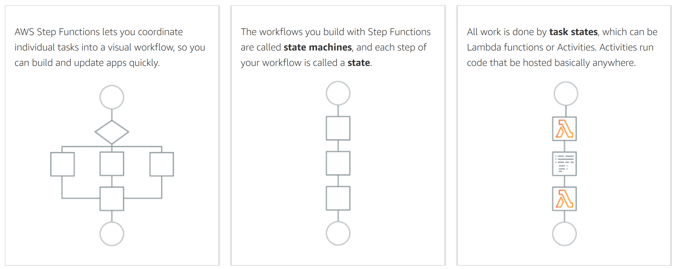
AWS step Function
Enables you to coordinate the components of distributed applications and microservices using visual workflows
Helps automate operational tasks.
It provides the auditable automation of routine deployments, upgrades, installations, and migrations.
Easily automate recurring tasks, such as patch management, infrastructure selection, and data synchronization.
Step Functions automatically scales, responds to timeouts, and retries failed tasks.
You can use Step Functions in combination with other services, such as AWS Lambda, to manage operational tasks in a workflow.

Slide 103
Sample Questions
You’re developing an application onto AWS which is based on the Microservices. These Microservices will be created based on AWS Lambda functions. Because of the complexity of the flow of these different components, you need some way to manage the workflow of execution of these various Lambda functions. How could you manage this effectively now and for the future addition of Lambda functions to the application?
a. Consider creating a master Lambda function that would coordinate the execution of the other Lambda functions.
b. Consider creating a separate application hosted on an EC2 Instance which would coordinate the execution of the other Lambda functions
c. Consider using Step Functions to coordinate the execution of the other Lambda functions
d. Consider using SQS queues to coordinate the execution of the other Lambda functions

Slide 104
Sample Questions
You’re developing an application onto AWS which is based on the Microservices. These Microservices will be created based on AWS Lambda functions. Because of the complexity of the flow of these different components, you need some way to manage the workflow of execution of these various Lambda functions. How could you manage this effectively now and for the future addition of Lambda functions to the application?
a. Consider creating a master Lambda function that would coordinate the execution of the other Lambda functions.
b. Consider creating a separate application hosted on an EC2 Instance which would coordinate the execution of the other Lambda functions
c. Consider using Step Functions to coordinate the execution of the other Lambda functions
d. Consider using SQS queues to coordinate the execution of the other Lambda functions

Slide 105
Sample Questions
You’re developing an application onto AWS which is based on the Microservices. These Microservices will be created based on AWS Lambda functions. Because of the complexity of the flow of these different components, you need some way to manage the workflow of execution of these various Lambda functions. How could you manage this effectively now and for the future addition of Lambda functions to the application?
a. Consider creating a master Lambda function that would coordinate the execution of the other Lambda functions.
b. Consider creating a separate application hosted on an EC2 Instance which would coordinate the execution of the other Lambda functions
c. Consider using Step Functions to coordinate the execution of the other Lambda functions
d. Consider using SQS queues to coordinate the execution of the other Lambda functions

Slide 106
Sample Questions
Your development team is planning on working with Amazon Step Functions. Which of the following is a recommended practice when working with activity workers and tasks in Step Functions? Choose 2 answers from the options given below.
a. Ensure to specify a timeout in state machine definitions
b. We can use only 1 transition per state.
c. If you are passing larger payloads between states, consider using the Simple Storage Service
d. If you are passing larger payloads between states, consider using EBS volumes

Slide 107
Sample Questions
Your development team is planning on working with Amazon Step Functions. Which of the following is a recommended practice when working with activity workers and tasks in Step Functions? Choose 2 answers from the options given below.
a. Ensure to specify a timeout in state machine definitions
b. We can use only 1 transition per state.
c. If you are passing larger payloads between states, consider using the Simple Storage Service
d. If you are passing larger payloads between states, consider using EBS volumes

Slide 108
Sample Questions
Your development team is planning on working with Amazon Step Functions. Which of the following is a recommended practice when working with activity workers and tasks in Step Functions? Choose 2 answers from the options given below.
a. Ensure to specify a timeout in state machine definitions
b. We can use only 1 transition per state.
c. If you are passing larger payloads between states, consider using the Simple Storage Service
d. If you are passing larger payloads between states, consider using EBS volumes

Slide 109
Sample Questions
Your company has setup an application in AWS. The application has been developed inhouse which consists of many distributed components. After initial launch of the application, important information which gets exchanged between components gets lost whenever one of the components is down. As a developer what can you suggest in resolving this issue?
a. Suggest the usage of the SQS service for messaging across the distributed components
b. Suggest the usage of the SNS service for messaging across the distributed components
c. Suggest the use of Cloudwatch logs to detect the issue in more detail
d. Suggest the use of Cloudtrail logs to detect the issue in more detail

Slide 110
Sample Questions
Your company has setup an application in AWS. The application has been developed inhouse which consists of many distributed components. After initial launch of the application, important information which gets exchanged between components gets lost whenever one of the components is down. As a developer what can you suggest in resolving this issue?
a. Suggest the usage of the SQS service for messaging across the distributed components
b. Suggest the usage of the SNS service for messaging across the distributed components
c. Suggest the use of Cloudwatch logs to detect the issue in more detail
d. Suggest the use of Cloudtrail logs to detect the issue in more detail

Slide 111
Sample Questions
Your company has setup an application in AWS. The application has been developed inhouse which consists of many distributed components. After initial launch of the application, important information which gets exchanged between components gets lost whenever one of the components is down. As a developer what can you suggest in resolving this issue?
a. Suggest the usage of the SQS service for messaging across the distributed components
b. Suggest the usage of the SNS service for messaging across the distributed components
c. Suggest the use of Cloudwatch logs to detect the issue in more detail
d. Suggest the use of Cloudtrail logs to detect the issue in more detail

Slide 112
Sample Questions
Your application utilizes Amazon S3 reduced redundancy storage and you have configured the sc.ReducedRedundancyLostObject notification on your Amazon S3 Bucket. What services might you use to create a "distributed" platform that replaces lost RRS objects on Amazon S3 automatically? Choose the correct answer from the options below
a. SNS with a website subscription endpoint as the worker instance
b. SNS with subscription endpoints
c. SNS with SQS subscription endpoint with a worker instance
d. SNS with an SMS subscription endpoint

Slide 113
Sample Questions
Your application utilizes Amazon S3 reduced redundancy storage and you have configured the sc.ReducedRedundancyLostObject notification on your Amazon S3 Bucket. What services might you use to create a "distributed" platform that replaces lost RRS objects on Amazon S3 automatically? Choose the correct answer from the options below
a. SNS with a website subscription endpoint as the worker instance
b. SNS with subscription endpoints
c. SNS with SQS subscription endpoint with a worker instance
d. SNS with an SMS subscription endpoint

Slide 114
Sample Questions
Your application utilizes Amazon S3 reduced redundancy storage and you have configured the sc.ReducedRedundancyLostObject notification on your Amazon S3 Bucket. What services might you use to create a "distributed" platform that replaces lost RRS objects on Amazon S3 automatically? Choose the correct answer from the options below
a. SNS with a website subscription endpoint as the worker instance
b. SNS with subscription endpoints
c. SNS with SQS subscription endpoint with a worker instance
d. SNS with an SMS subscription endpoint

Slide 115
Sample Questions
You are developing an application that will be comprised of the following architecture -
1. A set of EC2 instances to process the videos.
2. These (EC2 instances) will be spun up by an Autoscaling group.
3. SQS Queues to maintain the processing messages.
4. There will be 2 pricing tiers.
How will you ensure that the premium customers’ videos are given more preference?
a. Create 2 Autoscaling Groups, one for normal and one for premium customers
b. Create 2 sets of EC2 Instances, one for normal and one for premium customers
c. Create 2 SQS queues, one for normal and one for premium customers
d. Create 2 Elastic Load Balancers, one for normal and one for premium customers

Slide 116
Sample Questions
You are developing an application that will be comprised of the following architecture -
1. A set of EC2 instances to process the videos.
2. These (EC2 instances) will be spun up by an Autoscaling group.
3. SQS Queues to maintain the processing messages.
4. There will be 2 pricing tiers.
How will you ensure that the premium customers’ videos are given more preference?
a. Create 2 Autoscaling Groups, one for normal and one for premium customers
b. Create 2 sets of EC2 Instances, one for normal and one for premium customers
c. Create 2 SQS queues, one for normal and one for premium customers
d. Create 2 Elastic Load Balancers, one for normal and one for premium customers

Slide 117
Sample Questions
You are developing an application that will be comprised of the following architecture -
1. A set of EC2 instances to process the videos.
2. These (EC2 instances) will be spun up by an Autoscaling group.
3. SQS Queues to maintain the processing messages.
4. There will be 2 pricing tiers.
How will you ensure that the premium customers’ videos are given more preference?
a. Create 2 Autoscaling Groups, one for normal and one for premium customers
b. Create 2 sets of EC2 Instances, one for normal and one for premium customers
c. Create 2 SQS queues, one for normal and one for premium customers
d. Create 2 Elastic Load Balancers, one for normal and one for premium customers

Slide 118
Sample Questions
You have a set of developers that need to work with applications hosted on the Elastic Beanstalk environment. You need to ensure they can work with the beanstalk environments but not give them access to the AWS Console. How can you achieve this in the BEST way possible?
a. Ask them to manage the environments via the SDK
b. Ask them to manage the environments via the EB CLI
c. Ask them to manage the environments via an EC2 Instance
d. Ask them to manage the environments via an ECS cluster

Slide 119
Sample Questions
You have a set of developers that need to work with applications hosted on the Elastic Beanstalk environment. You need to ensure they can work with the beanstalk environments but not give them access to the AWS Console. How can you achieve this in the BEST way possible?
a. Ask them to manage the environments via the SDK
b. Ask them to manage the environments via the EB CLI
c. Ask them to manage the environments via an EC2 Instance
d. Ask them to manage the environments via an ECS cluster

Slide 120
Sample Questions
You have a set of developers that need to work with applications hosted on the Elastic Beanstalk environment. You need to ensure they can work with the beanstalk environments but not give them access to the AWS Console. How can you achieve this in the BEST way possible?
a. Ask them to manage the environments via the SDK
b. Ask them to manage the environments via the EB CLI
c. Ask them to manage the environments via an EC2 Instance
d. Ask them to manage the environments via an ECS cluster

Slide 121
Sample Questions
. Which API call occurs in the final process of creating an Instance Store AMI? Choose the correct answer from the options below
a. CreateImage
b. RegisterImage
c. ami-register-image
d. ami-create-image

Slide 122
Sample Questions
. Which API call occurs in the final process of creating an Instance Store AMI? Choose the correct answer from the options below
a. CreateImage
b. RegisterImage
c. ami-register-image
d. ami-create-image

Slide 123
Sample Questions
. Which API call occurs in the final process of creating an Instance Store AMI? Choose the correct answer from the options below
a. CreateImage
b. RegisterImage
c. ami-register-image
d. ami-create-image

Slide 124
Happy Learning!!
124

